Slide 1
Changing the Digital Climate
How Climate Change Web Content is Being Censored Under the Trump Administration
2019-02-27
Puneeth Bikkasandra
CS795/895
@PuneethBikks
@WebSciDL

Slide 2
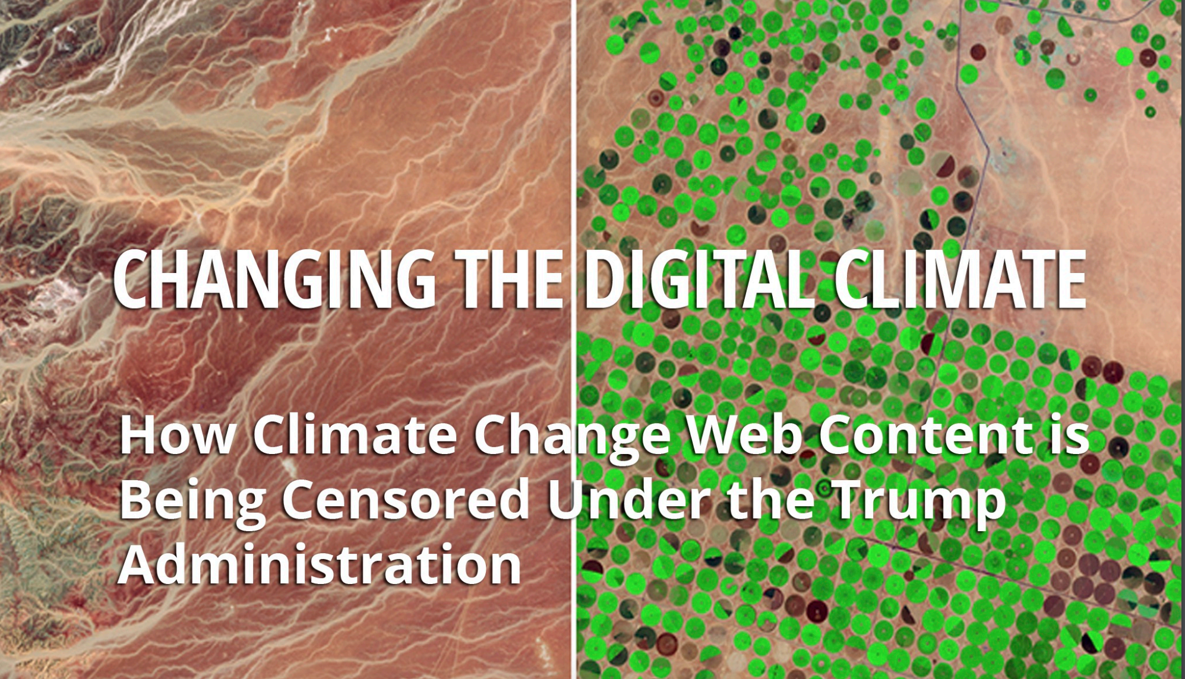
https://envirodatagov.org/wp-content/uploads/2018/01/Part-3-Changing-the-Digital-Climate.pdf#page=15&zoom=100,0,374

Slide 3
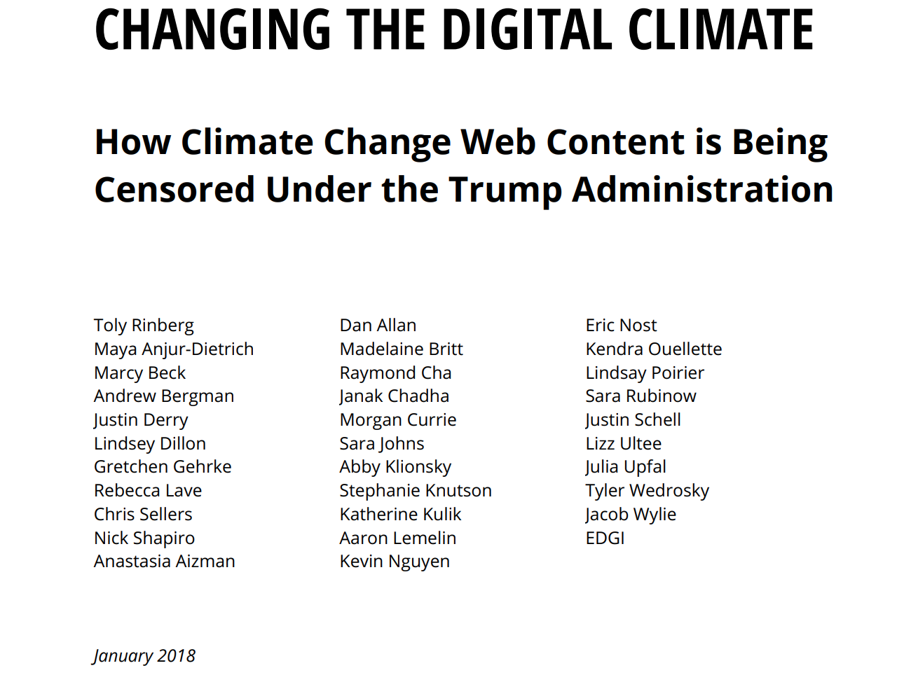
https://envirodatagov.org/wp-content/uploads/2018/01/Part-3-Changing-the-Digital-Climate.pdf#page=15&zoom=100,0,374

Slide 4
Climate change and role of US Government
Produces and funds data consumed by global climate community.
Agencies serve a critical and authoritative role in forming science-based policies.
U.S. policy shifts have implications far beyond its borders.
Withdraws landmark Paris Agreement, Ignores climate experts who warn about irreversible consequences.
National Security Strategy, 2017 confirms breaking of norms by removing climate change from a list of global threats.
https://envirodatagov.org/wp-content/uploads/2018/01/Part-3-Changing-the-Digital-Climate.pdf#page=15&zoom=100,0,374
https://docs.google.com/presentation/d/1FWnArIGZXhiyce0Jd7HMxfoksz-PA3JaKQ22mBiic4M/edit#slide=id.g5081bdbad1_0_82

Slide 5
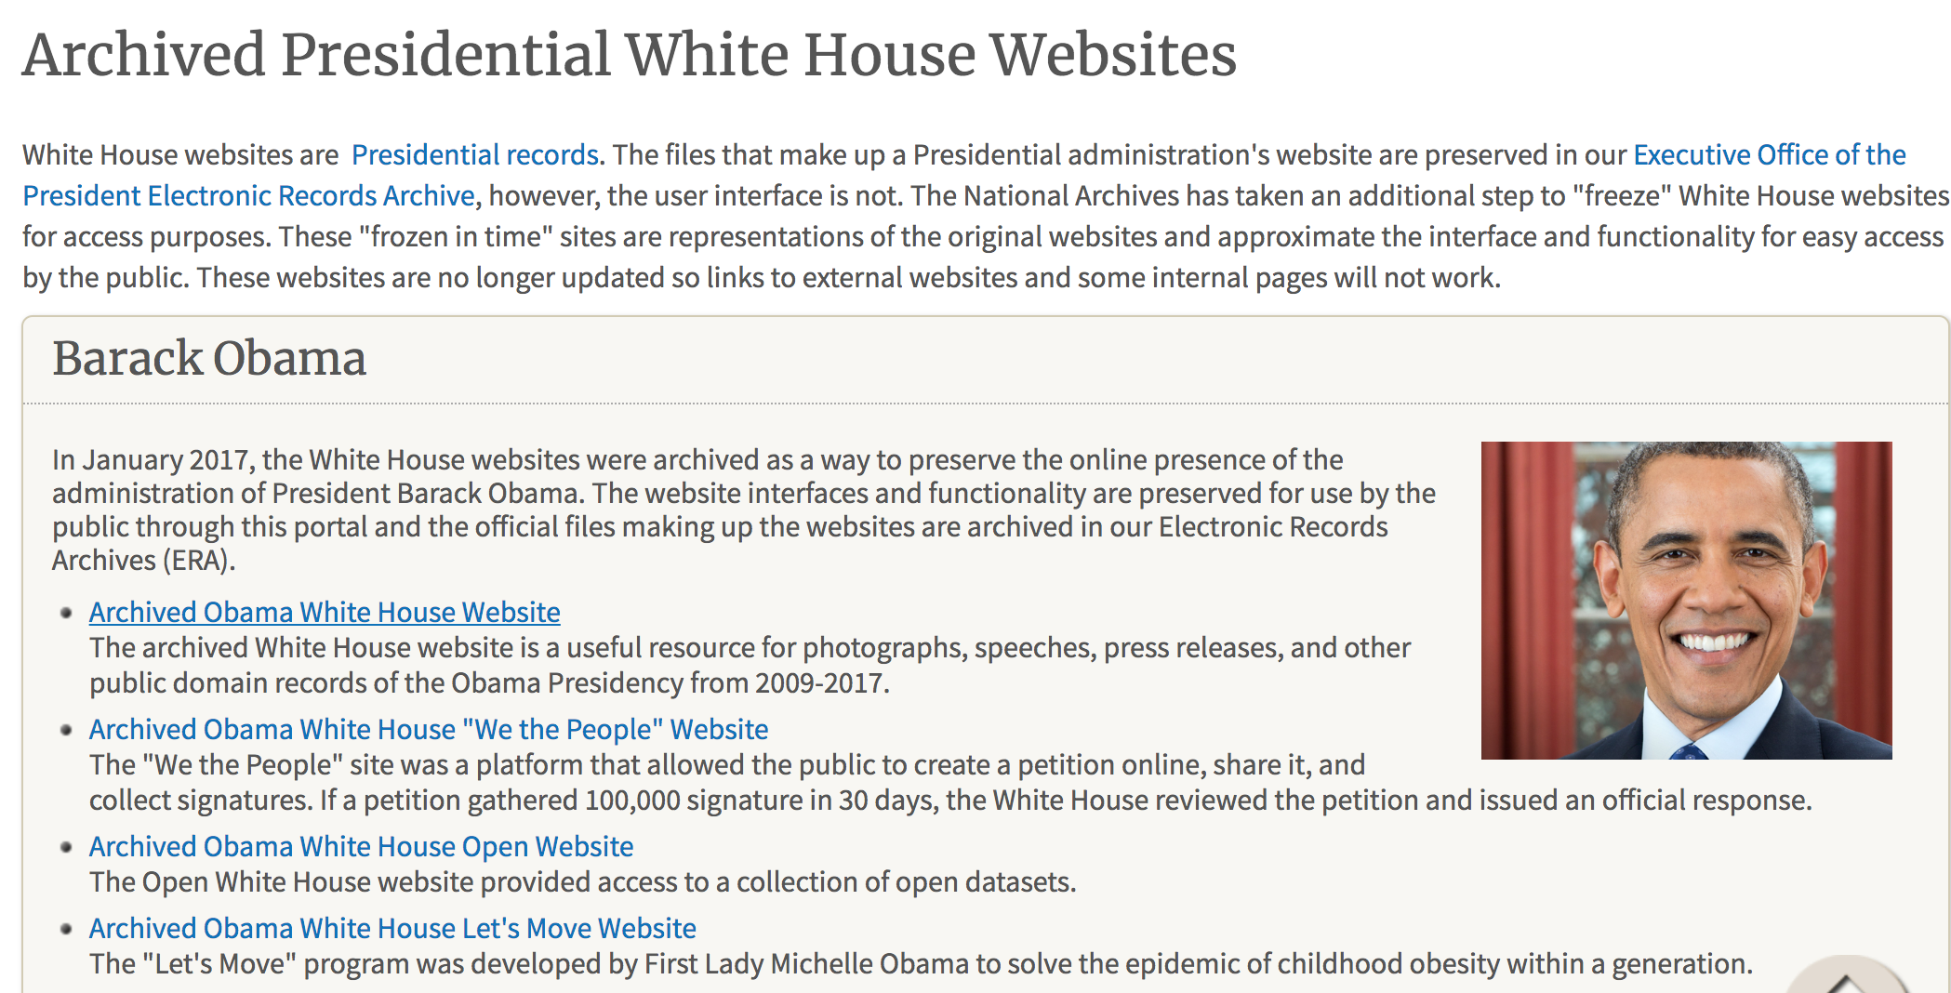
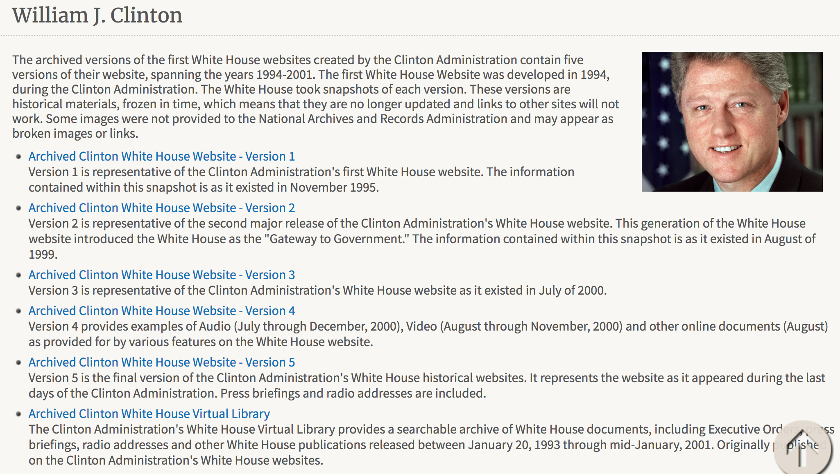
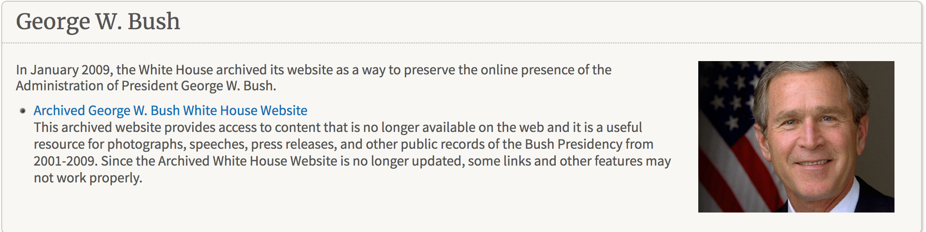
Archives of previous administrations
https://www.archives.gov/presidential-libraries/archived-websites
https://envirodatagov.org/wp-content/uploads/2018/01/Part-3-Changing-the-Digital-Climate.pdf#page=15&zoom=100,0,374

Slide 6
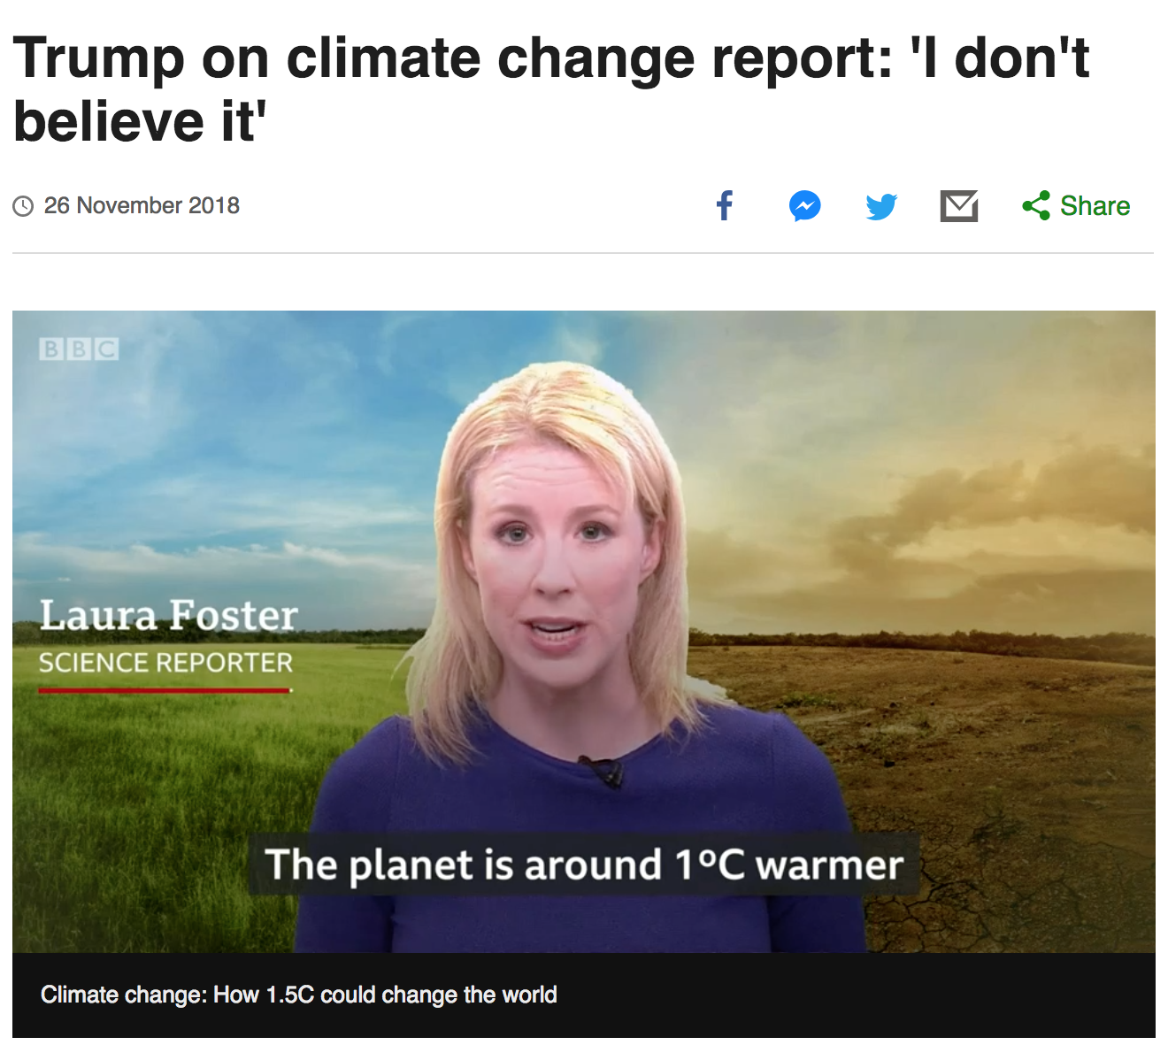
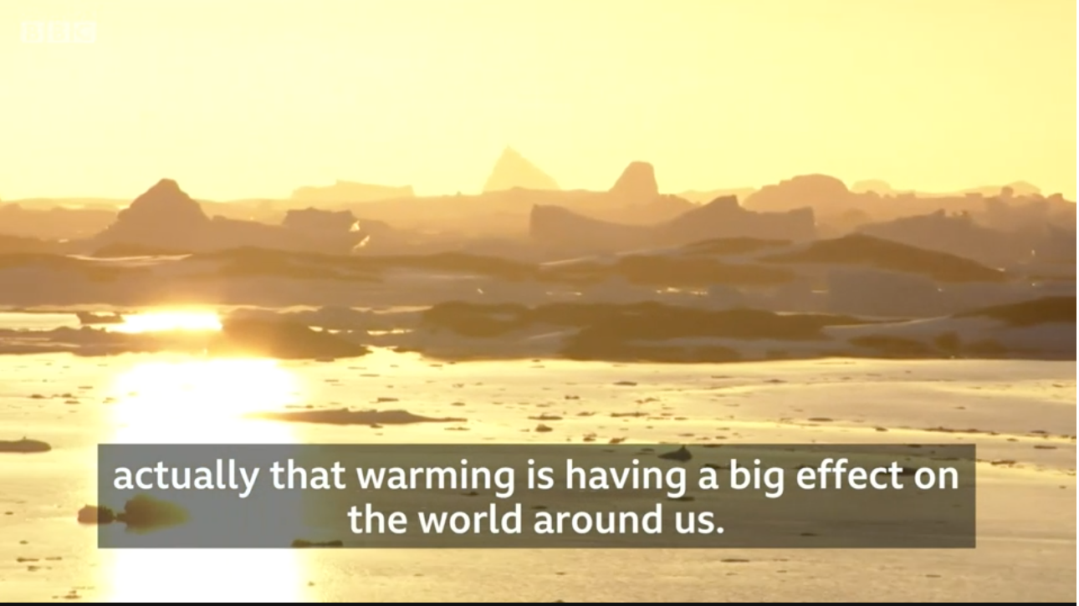

Mr. Trump refers to climate change as a hoax!
https://www.bbc.com/news/world-us-canada-46351940

Slide 7
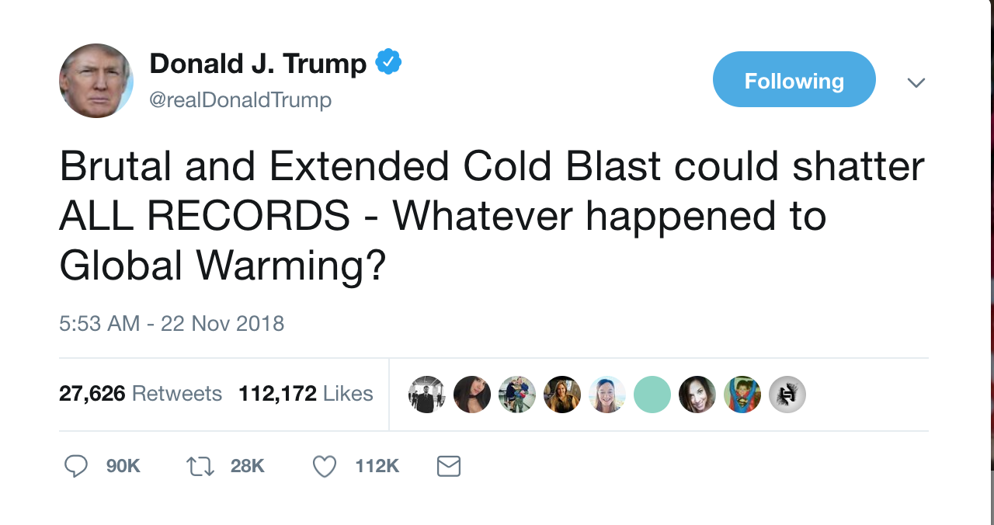
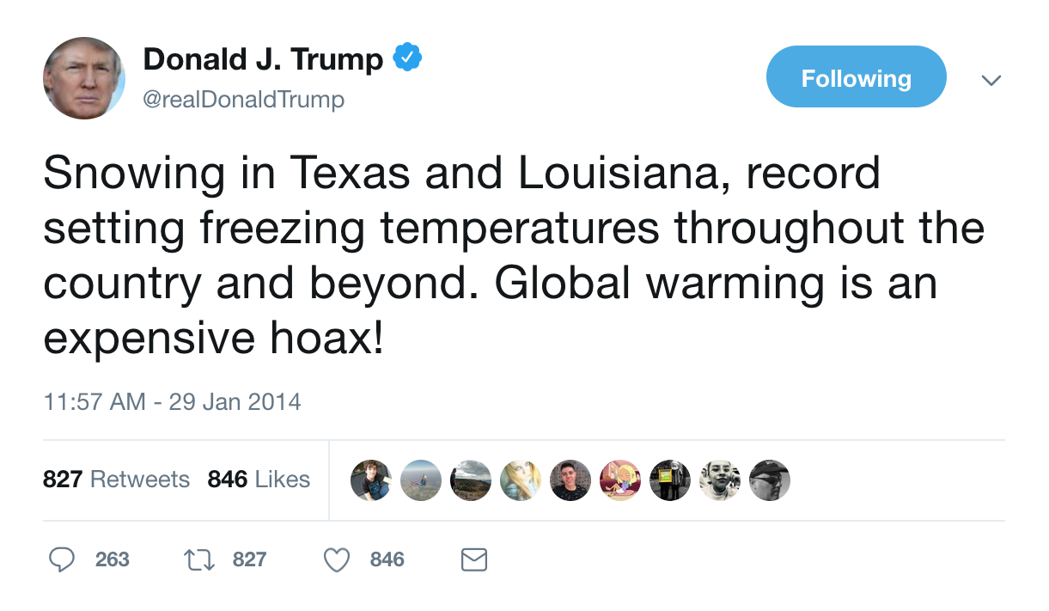
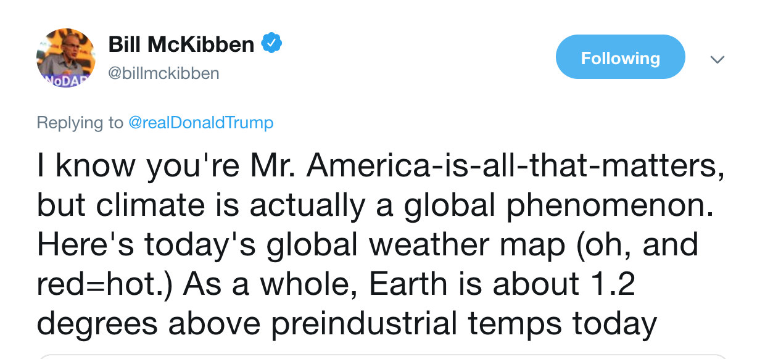
https://www.huffingtonpost.com/entry/donald-trump-climate-change-tweet_us_5bf6019ae4b0eb6d930b6d25

Slide 8
Federal websites currently not aligned with climate change
White House
State Department’s Office of Global Change
Office of Energy Efficiency and Renewable Energy
Bureau of Land Management
Energy Information Administration’s (EIA) Energy Kids website
Environmental Protection Agency
https://envirodatagov.org/wp-content/uploads/2018/01/Part-3-Changing-the-Digital-Climate.pdf#page=15&zoom=100,0,374

Slide 9
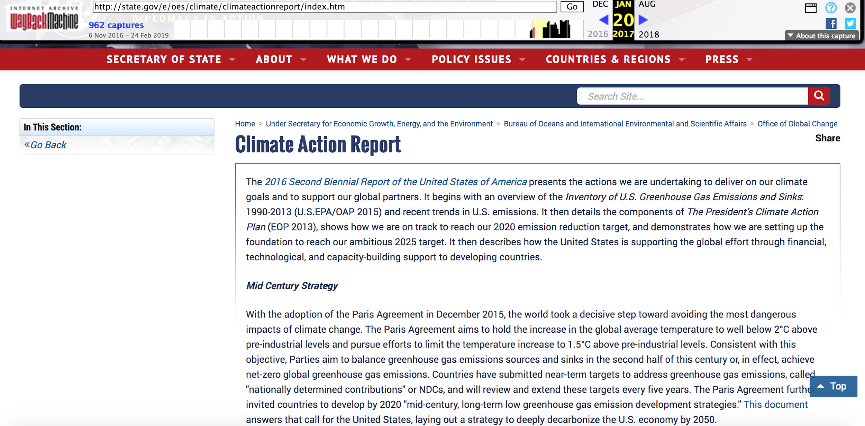
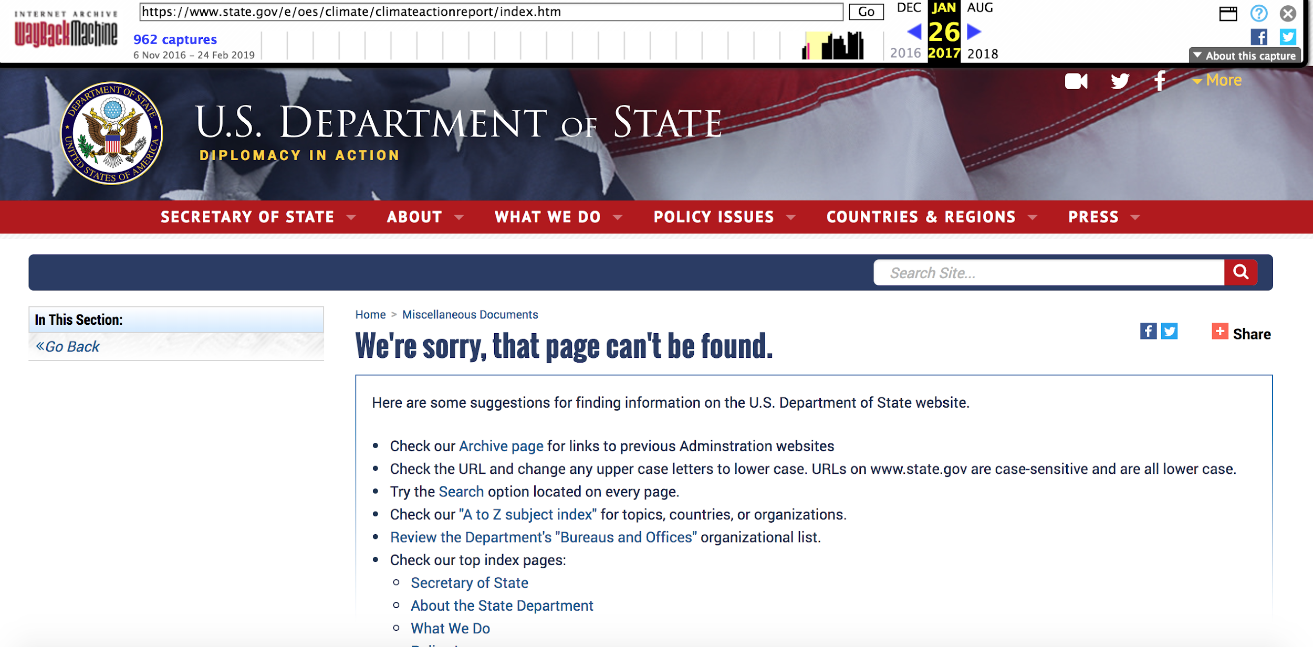
Reports pertaining to climate change removed
January 20, 2017
(vs)
January 26, 2017
The State Department removed Climate Action Reports and pages describing them.
https://web.archive.org/web/20170120155019/state.gov/e/oes/climate/climateactionreport/index.htm
https://web.archive.org/web/20170126125104/https://www.state.gov/e/oes/climate/climateactionreport/index.htm

Slide 10
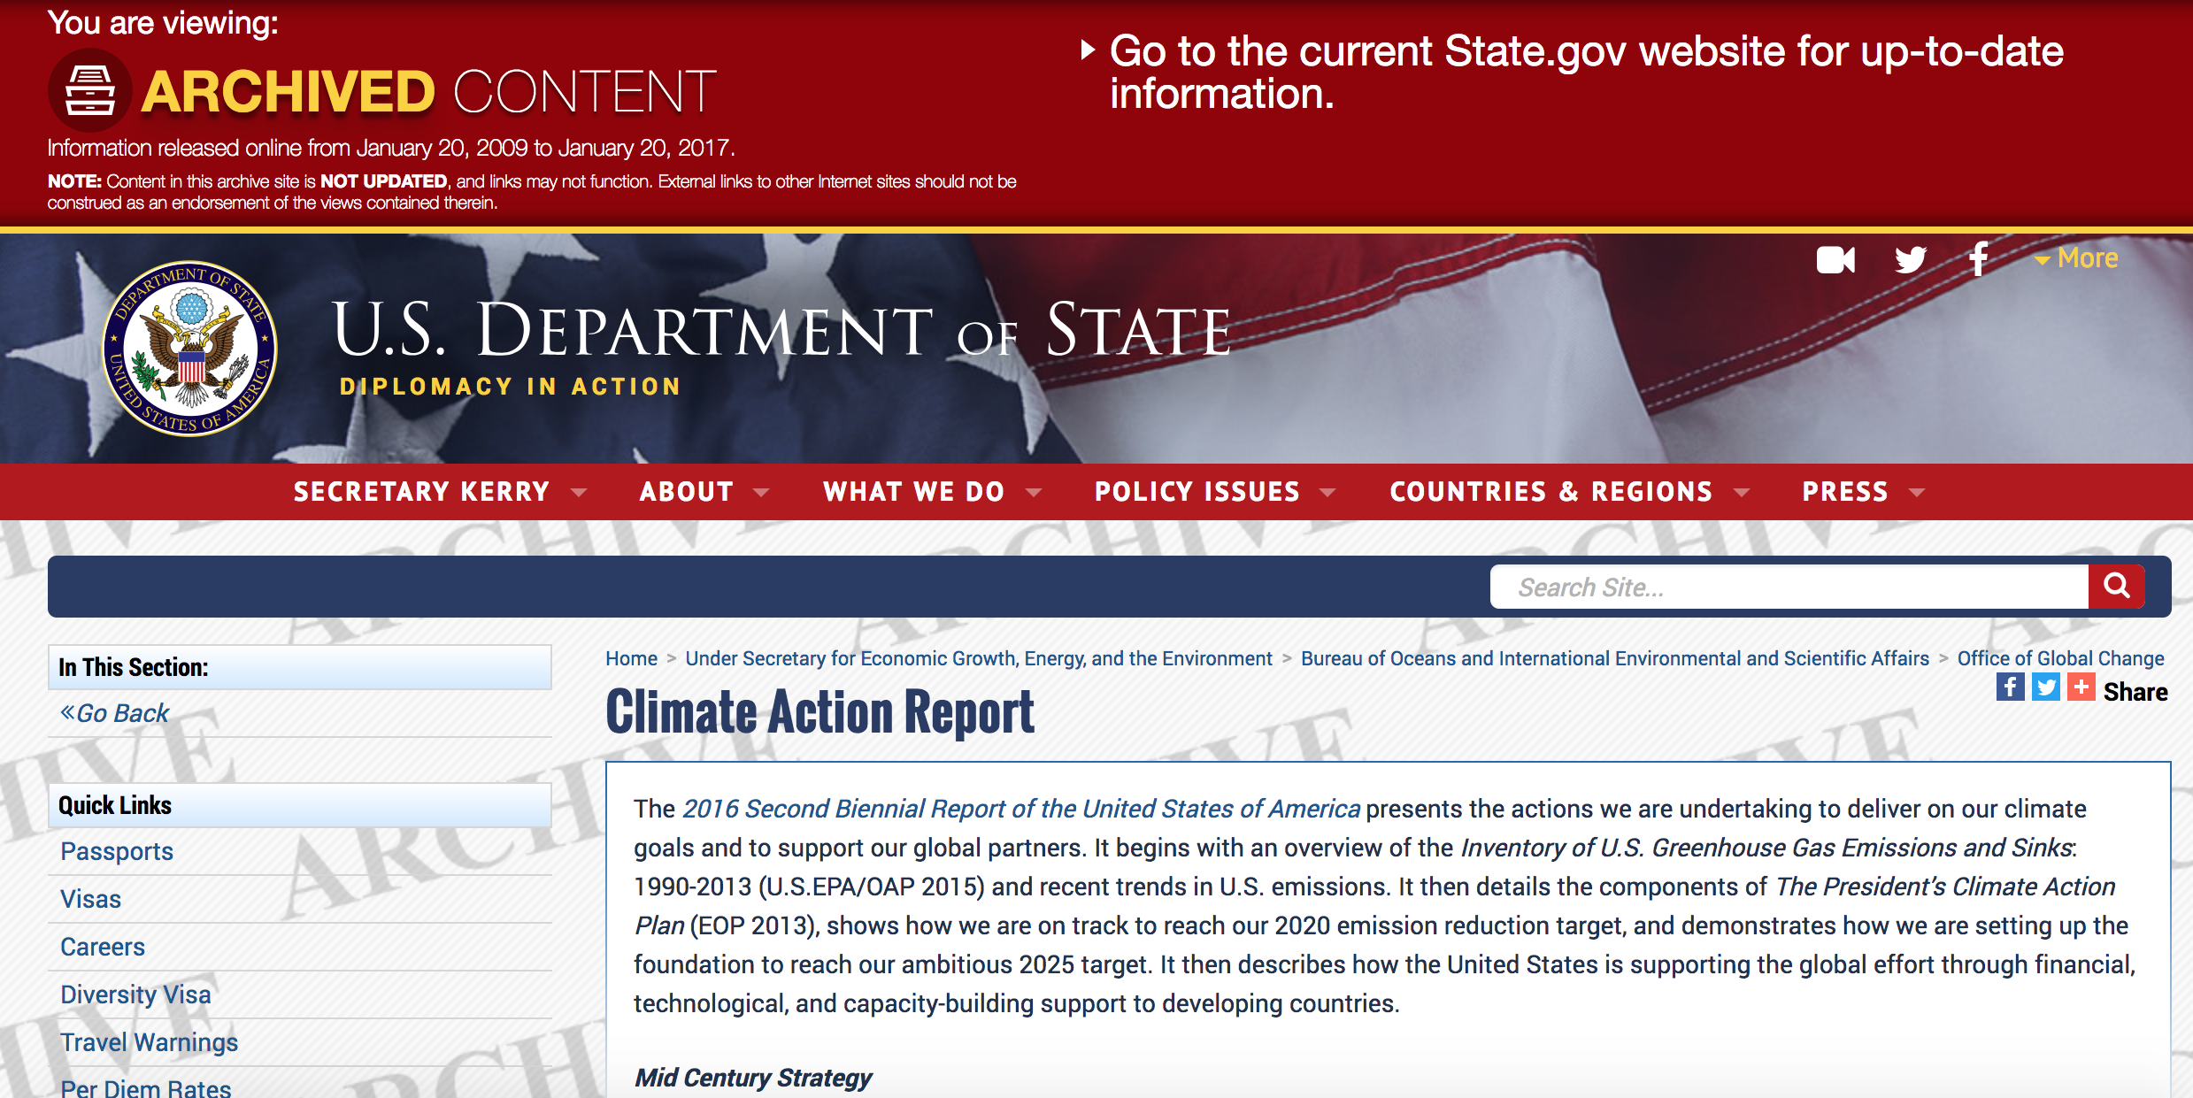
From the US govt. Archive!
https://2009-2017.state.gov/e/oes/climate/climateactionreport/index.htm

Slide 11
No redirection for Montreal Protocol Pages!
curl -i https://www.state.gov/e/oes/hfcs/254140.htm
HTTP/1.1 404 Not Found
Server: Apache
ETag: "ca9e9f0e40dbb334bfc1db332b929056:1532735098"
Last-Modified: Fri, 27 Jul 2018 23:44:58 GMT
Accept-Ranges: bytes
Content-Length: 14581
https://web.archive.org/web/20170114033840/https://www.state.gov/e/oes/hfcs/index.htm

Slide 12
Archived!
curl --silent http://memgator.cs.odu.edu/timemap/link/https://www.state.gov/e/oes/hfcs/254140.htm | grep datetime | awk '{print $1}' | awk -v FS=/ '{print $3}' | sort | uniq -c
2 wayback.archive-it.org
5 web.archive.org

Slide 13
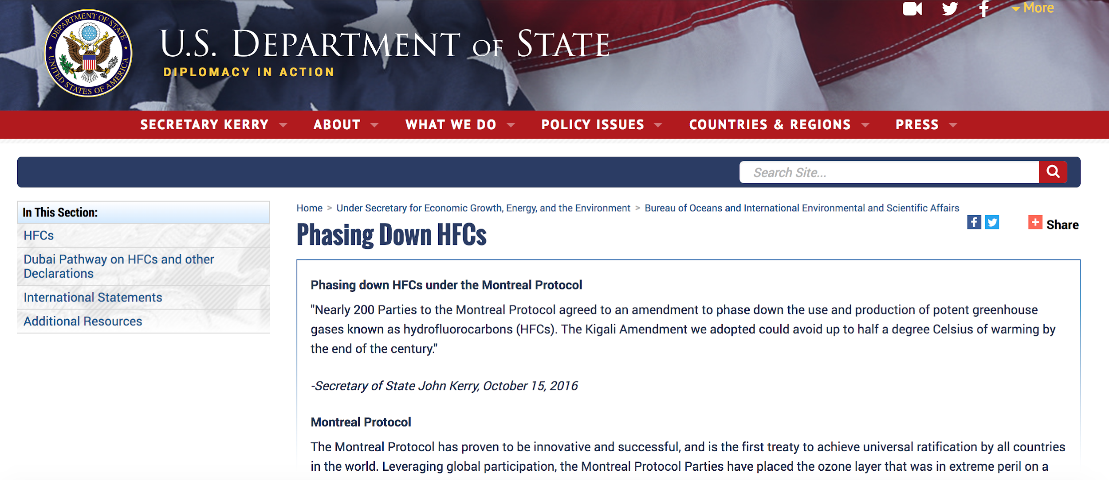
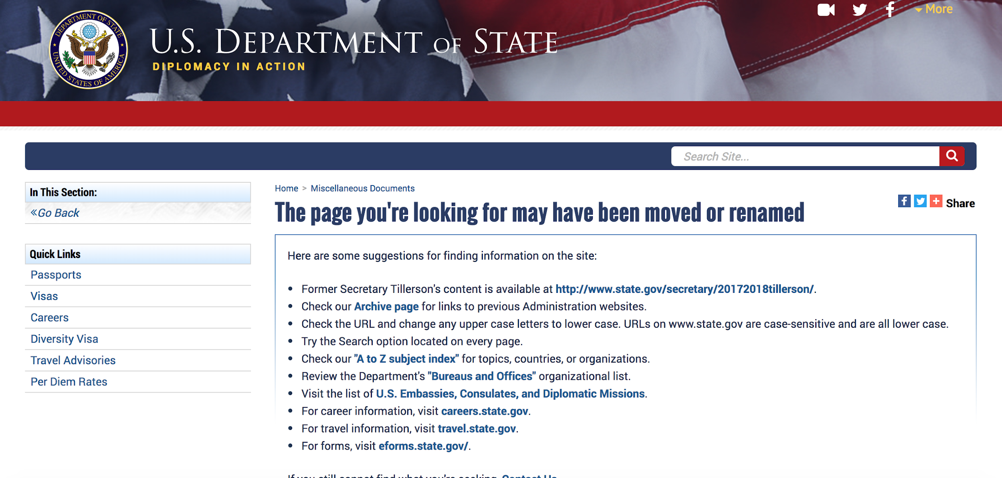
Pages describing the Montreal Protocol removed!
https://www.state.gov/e/oes/hfcs/index.htm
https://web.archive.org/web/20170114033840/https://www.state.gov/e/oes/hfcs/index.htm

Slide 14
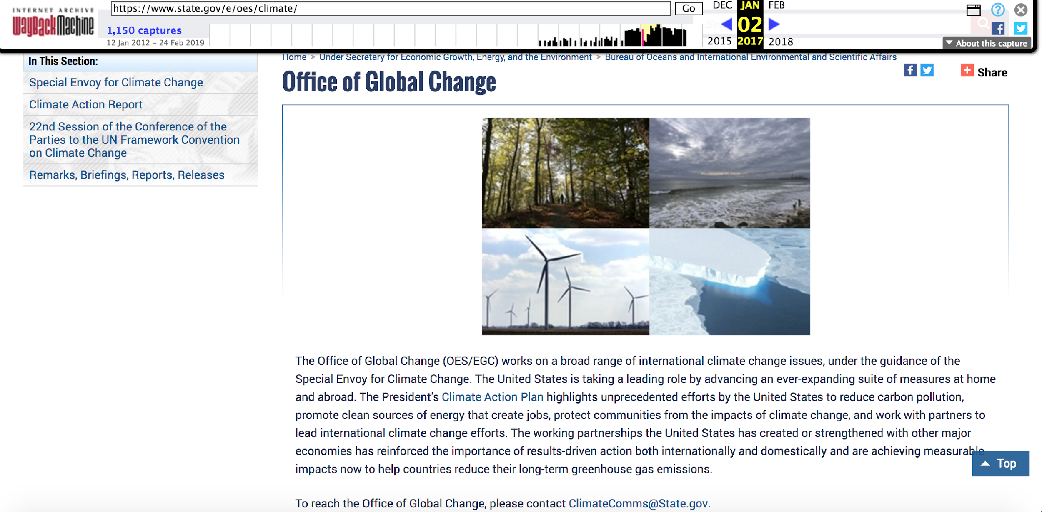
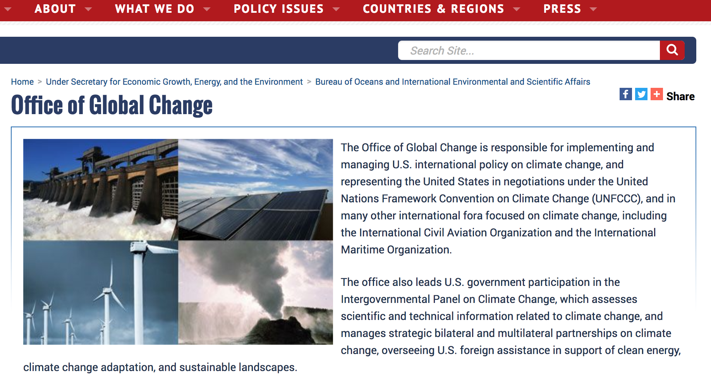
Changes to the State Department’s Office of Global Change
Jan 02, 2017
Jan 25, 2017 Onwards
https://web.archive.org/web/20170125215346/https://www.state.gov/e/oes/climate/
https://web.archive.org/web/20170102202342/https://www.state.gov/e/oes/climate/
https://envirodatagov.org/wp-content/uploads/2017/07/WM-CCR-6-State-Office-of-Global-Change-Updated-170412.pdf

Slide 15
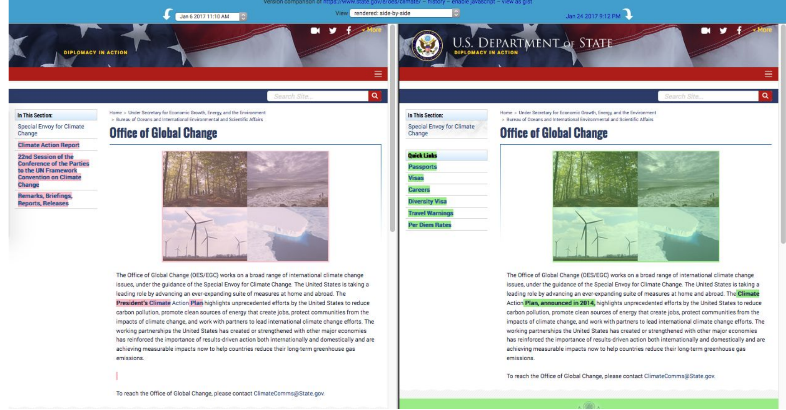
Removal of the descriptor “President’s” from “Climate Action Plan”
Jan 2, 2017 (vs) Jan 22, 2017
https://envirodatagov.org/wp-content/uploads/2017/07/WM-CCR-6-State-Office-of-Global-Change-Updated-170412.pdf
https://web.archive.org/web/20170102202342/https://www.state.gov/e/oes/climate/
https://web.archive.org/web/20170122030850/https://www.state.gov/e/oes/climate/

Slide 16
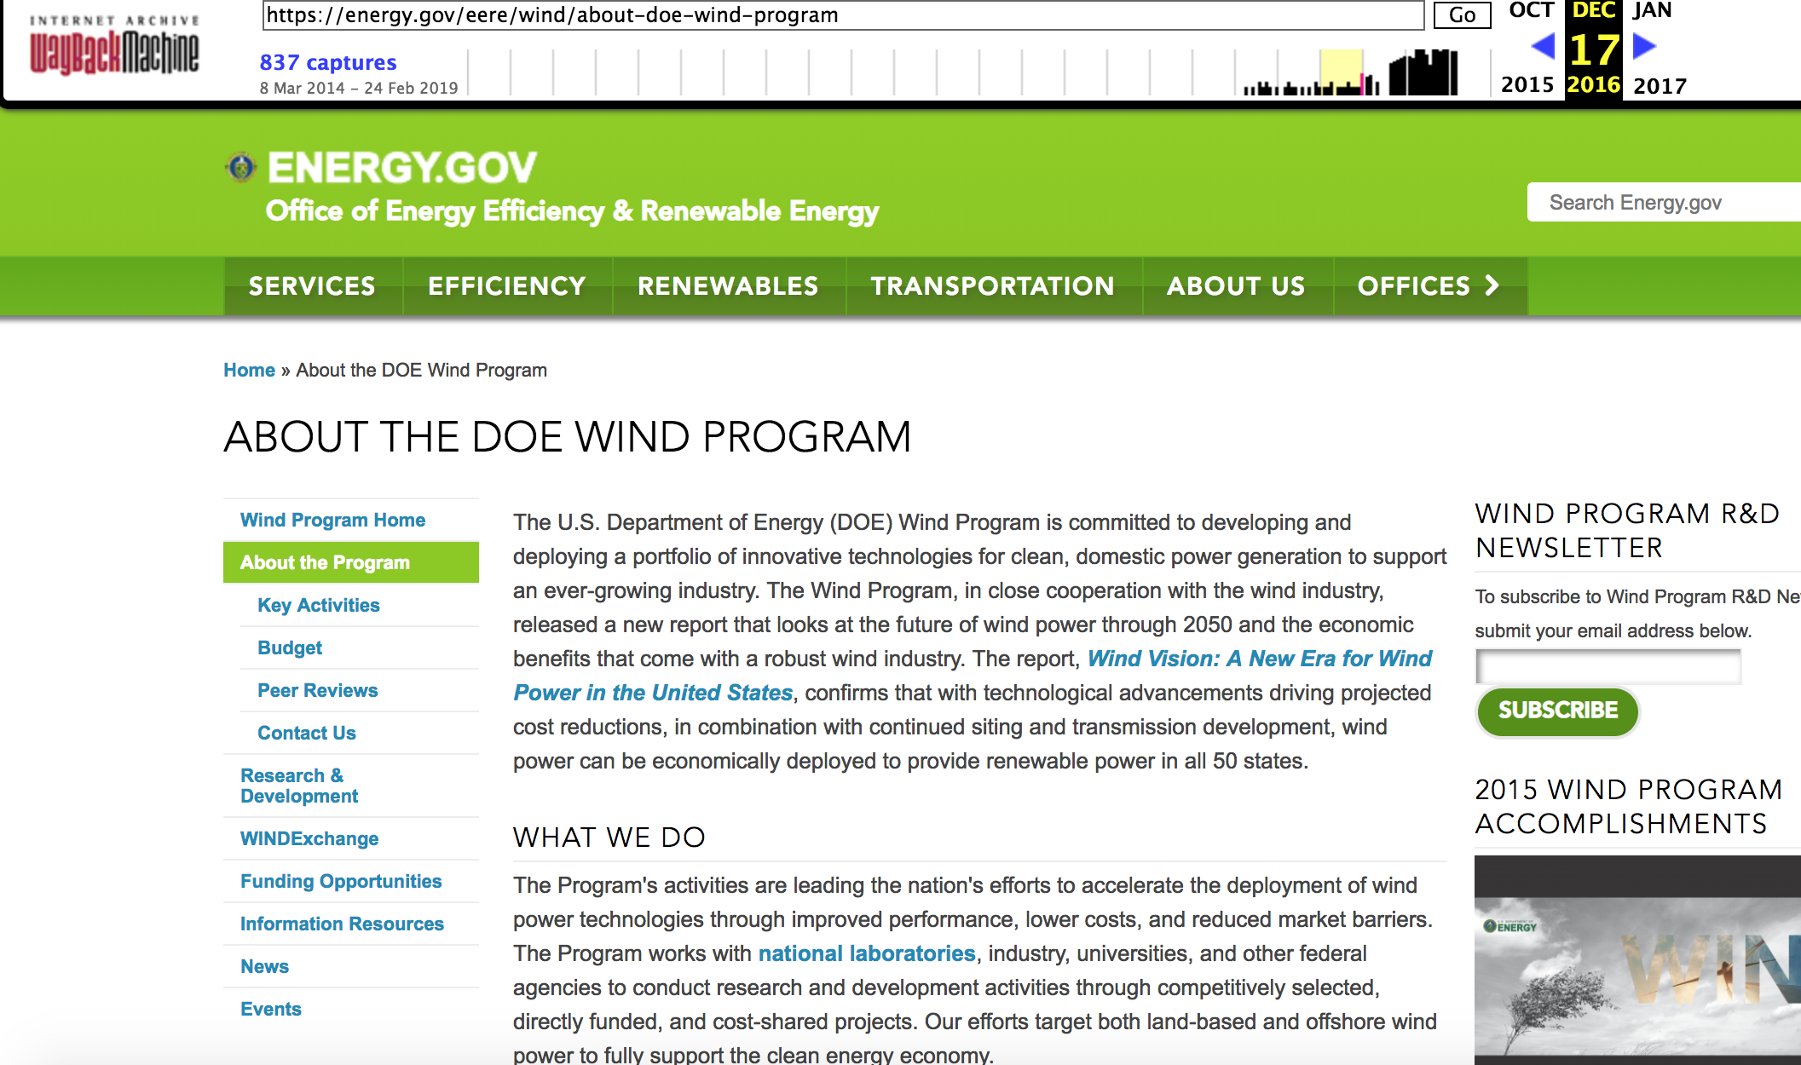
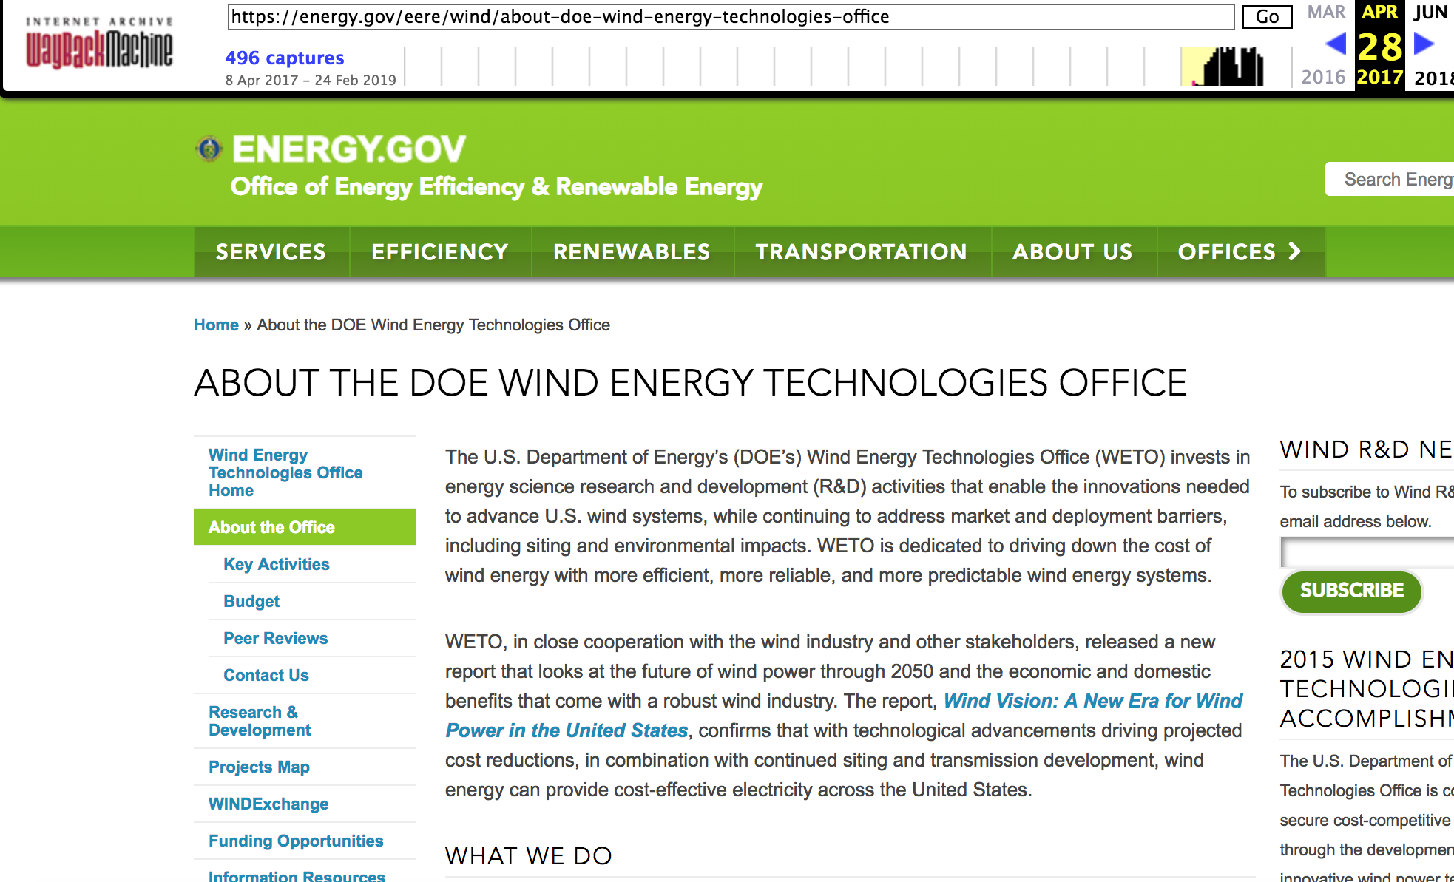
Changes to DOE’s Official Web Pages (Title Change)
Dec 17, 2016 (vs) April 28, 2017
https://web.archive.org/web/20161217183720/https://energy.gov/eere/wind/about-doe-wind-program
https://web.archive.org/web/20170428151720/https://energy.gov/eere/wind/about-doe-wind-energy-technologies-office
https://envirodatagov.org/wp-content/uploads/2017/07/WM-CCR-12-EERE-Wind-Technologies-Office-170419.pdf

Slide 17
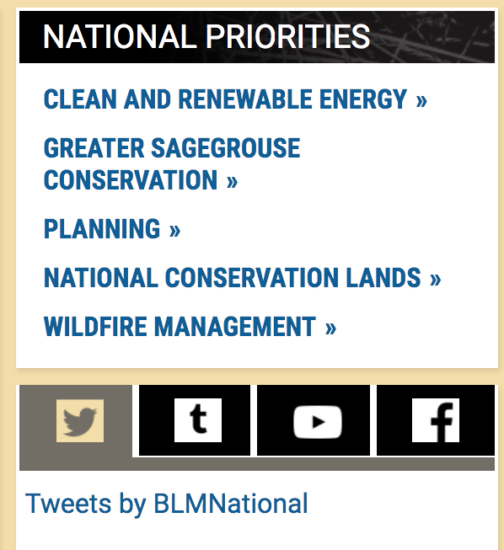
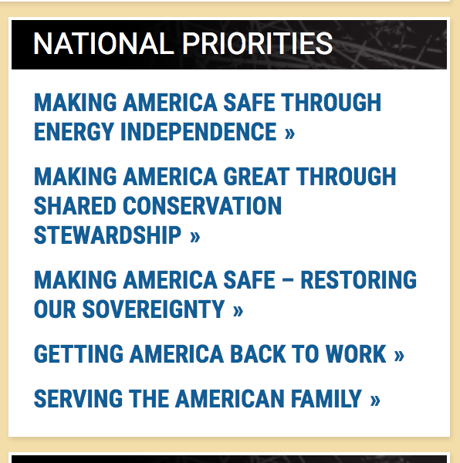
BLM Website Changes: Feb 7, 2017 (vs) November 26, 2017
https://web.archive.org/web/20170207060252/https://www.blm.gov/about
https://web.archive.org/web/20171126184421/https://www.blm.gov/about

Slide 18
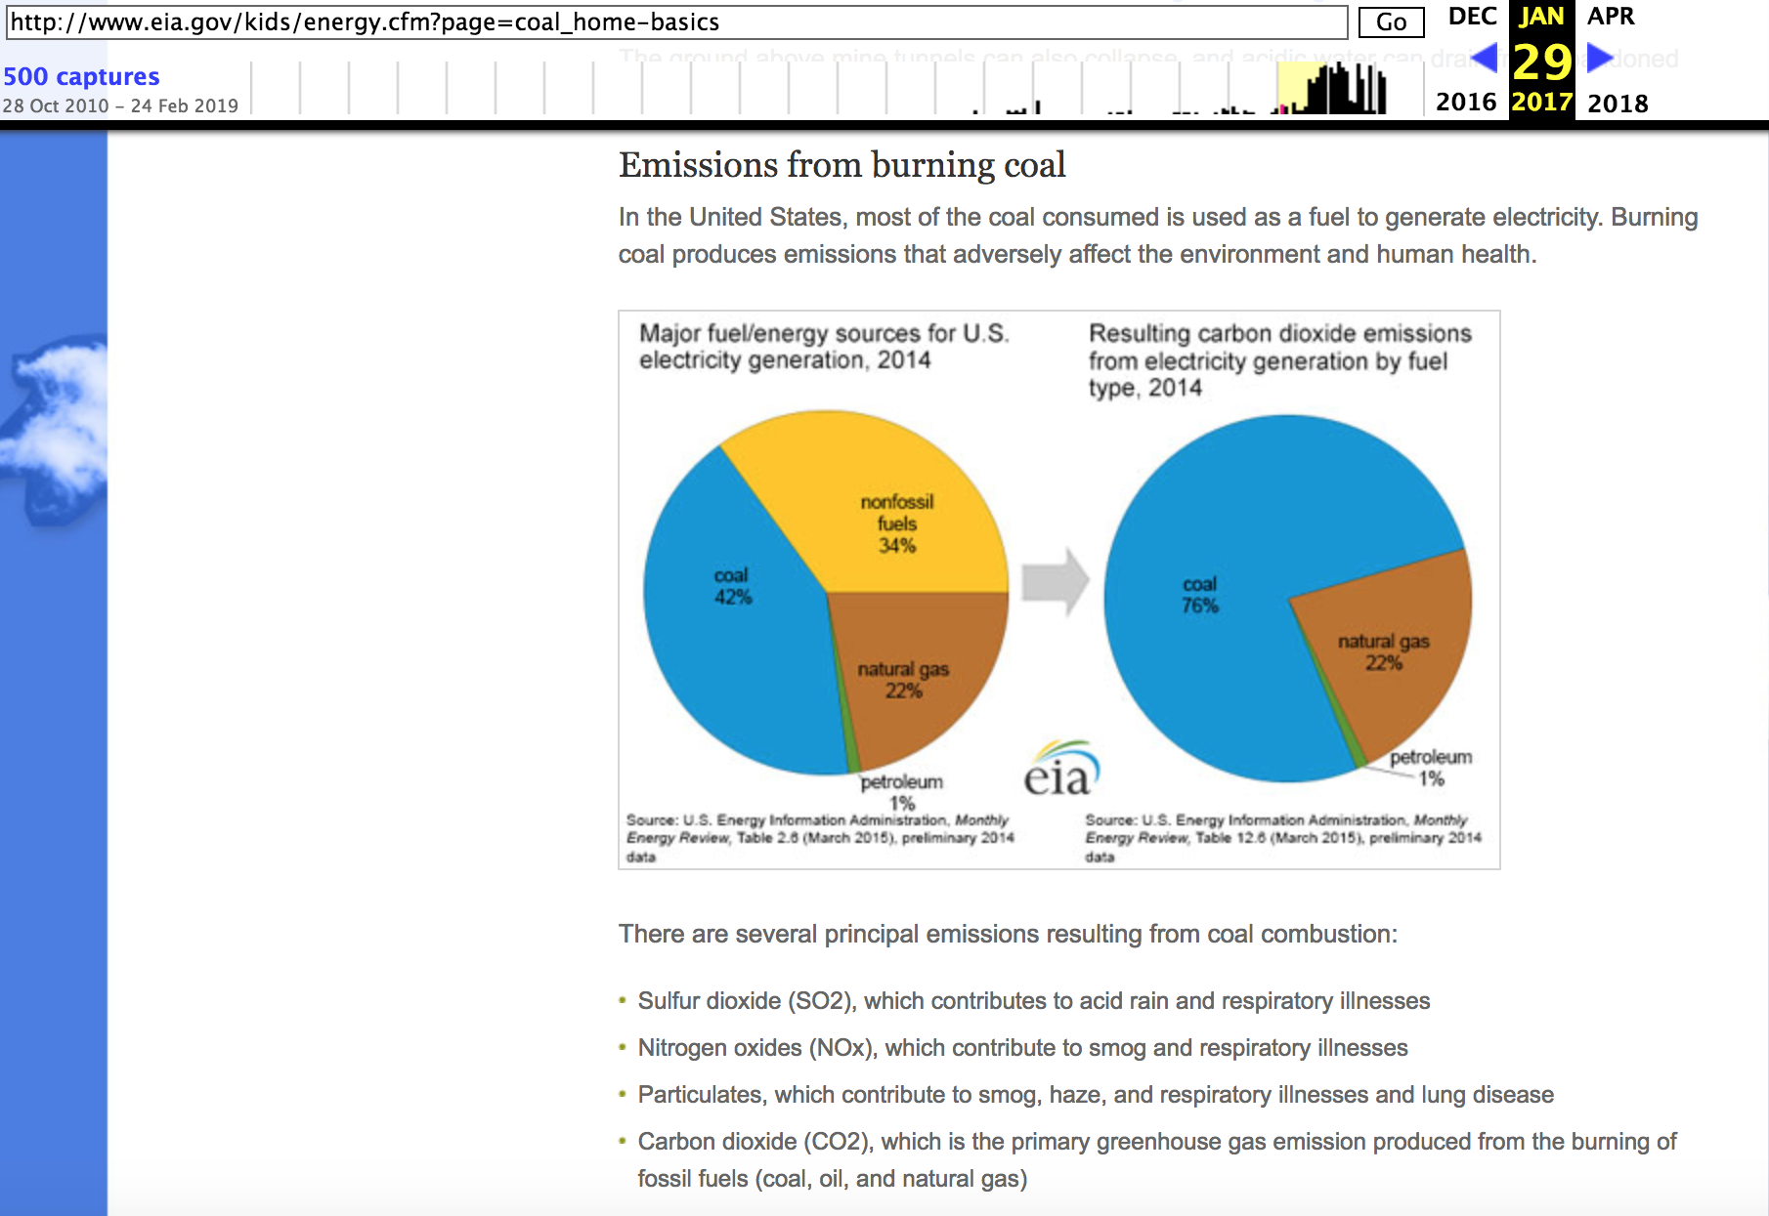
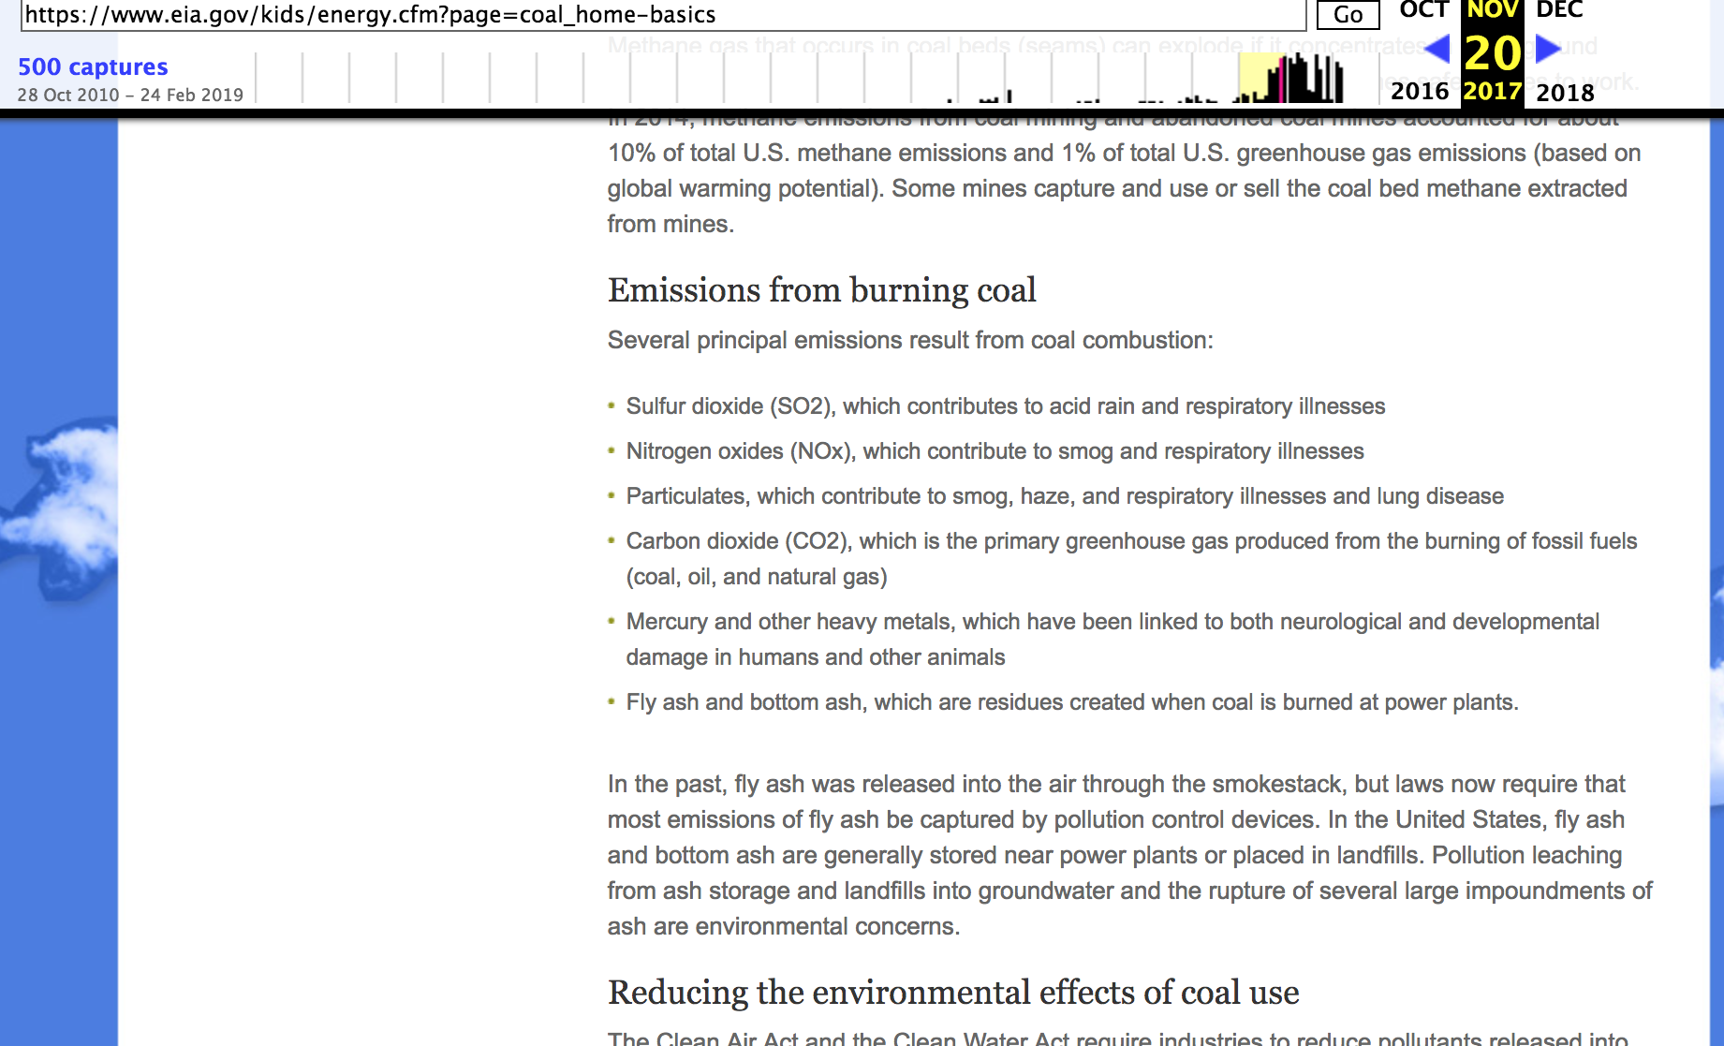
Energy Information Administration’s (EIA) Energy Kids website.
A sentence and graph about coal removed from EIA website
https://web.archive.org/web/20170129065042/http://www.eia.gov/kids/energy.cfm?page=coal_home-basics
https://web.archive.org/web/20171120190803/https://www.eia.gov/kids/energy.cfm?page=coal_home-basics
https://envirodatagov.org/wp-content/uploads/2018/01/Part-3-Changing-the-Digital-Climate.pdf#page=15&zoom=100,0,374

Slide 19
“eia.gov/kids” in other archives
curl --silent http://memgator.cs.odu.edu/timemap/link/http://www.eia.gov/kids/energy.cfm?page=oil_home-basics | grep datetime | awk '{print $1}' | awk -v FS=/ '{print $3}' | sort | uniq -c
2 archive.md
491 web.archive.org

Slide 20
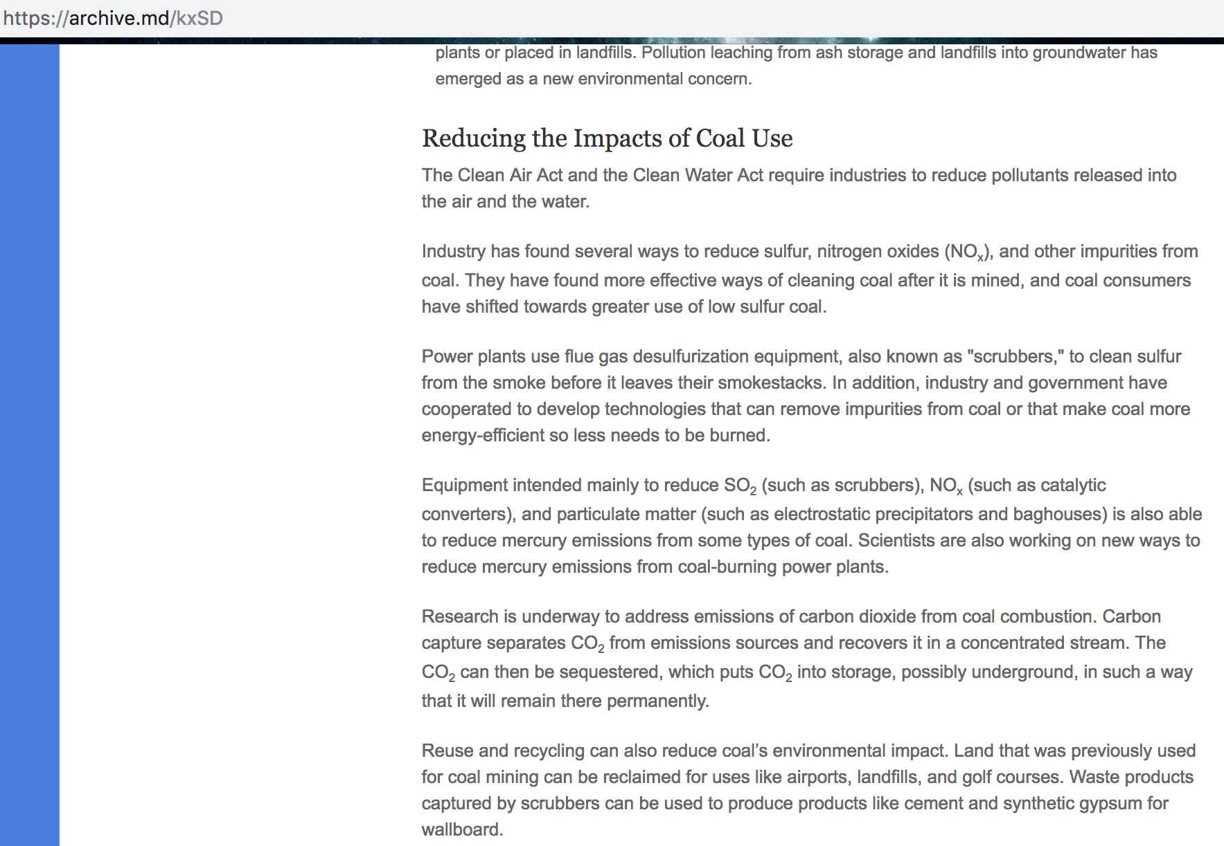
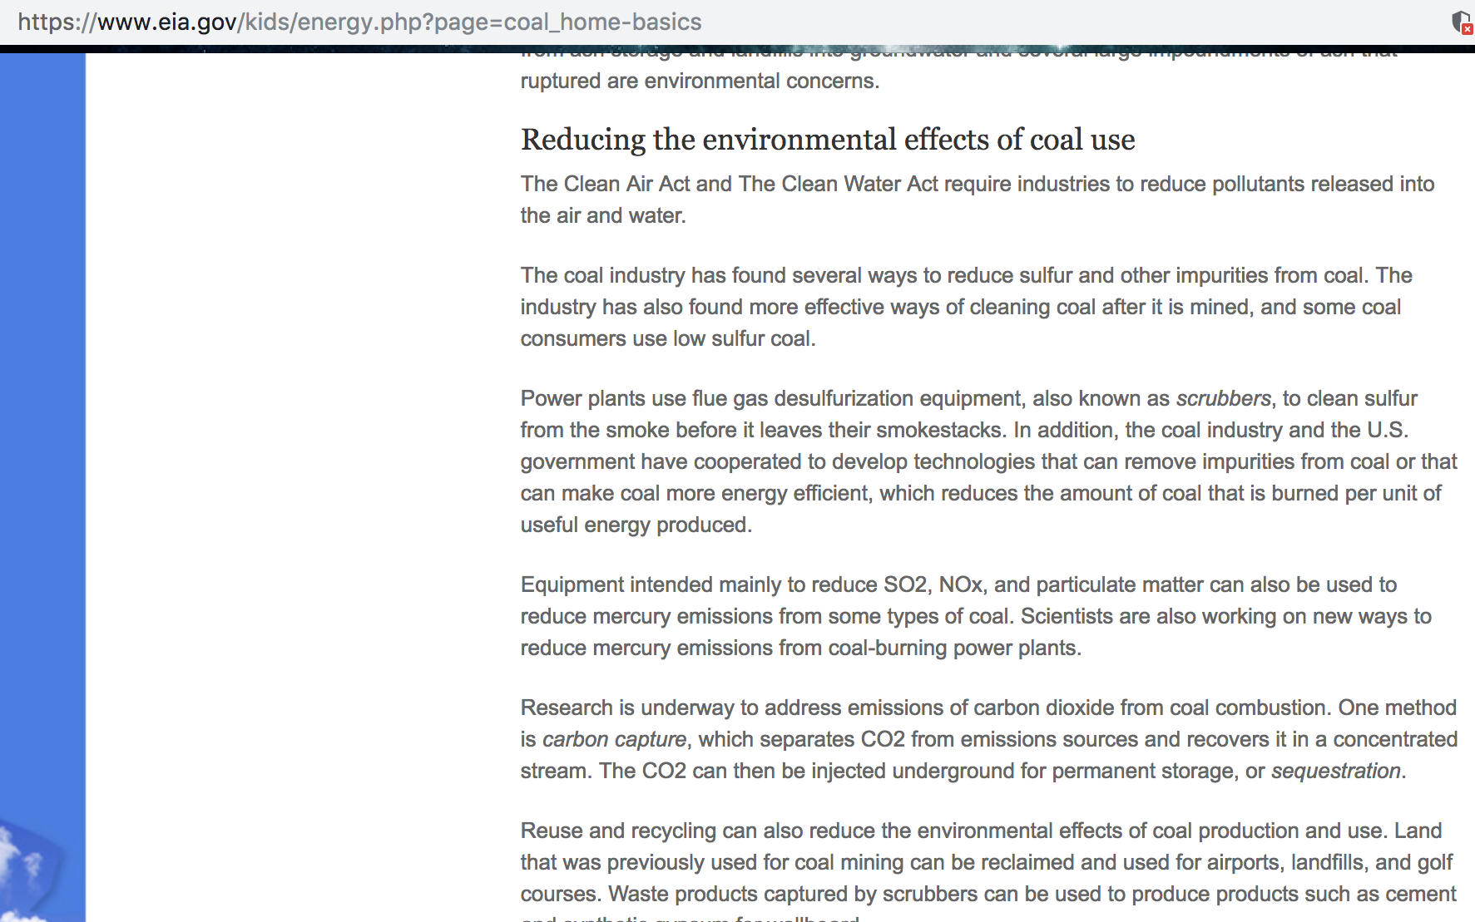
“Impacts” changed to “effects”
July 12, 2012
Jan 24, 2017
https://archive.md/kxSD
https://www.eia.gov/kids/energy.php?page=coal_home-basics

Slide 21
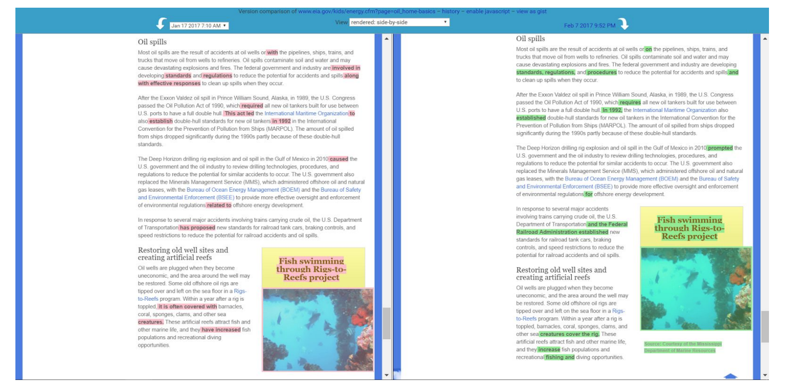
Changes to Semantics!
http://web.archive.org/web/20170128170642/http://www.eia.gov/kids/energy.cfm?page=oil_home-basics
http://web.archive.org/web/20170223160119/http://www.eia.gov/kids/energy.cfm?page=oil_home-basics

Slide 22
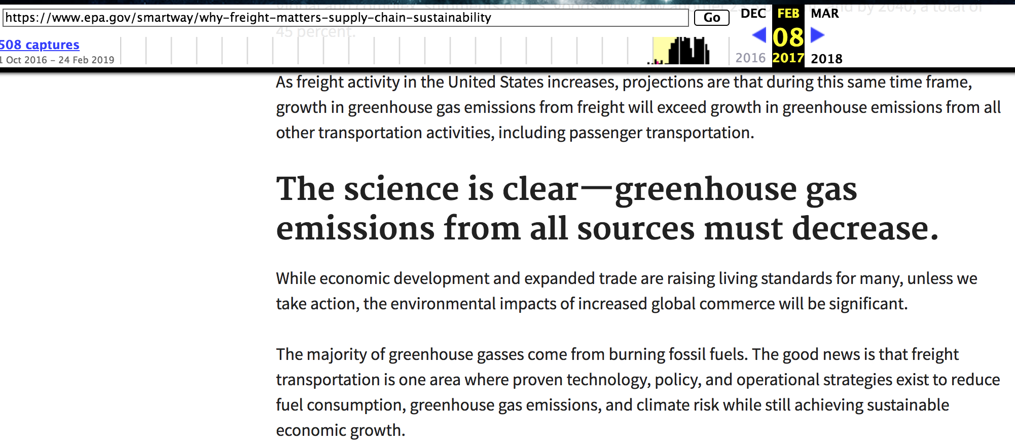
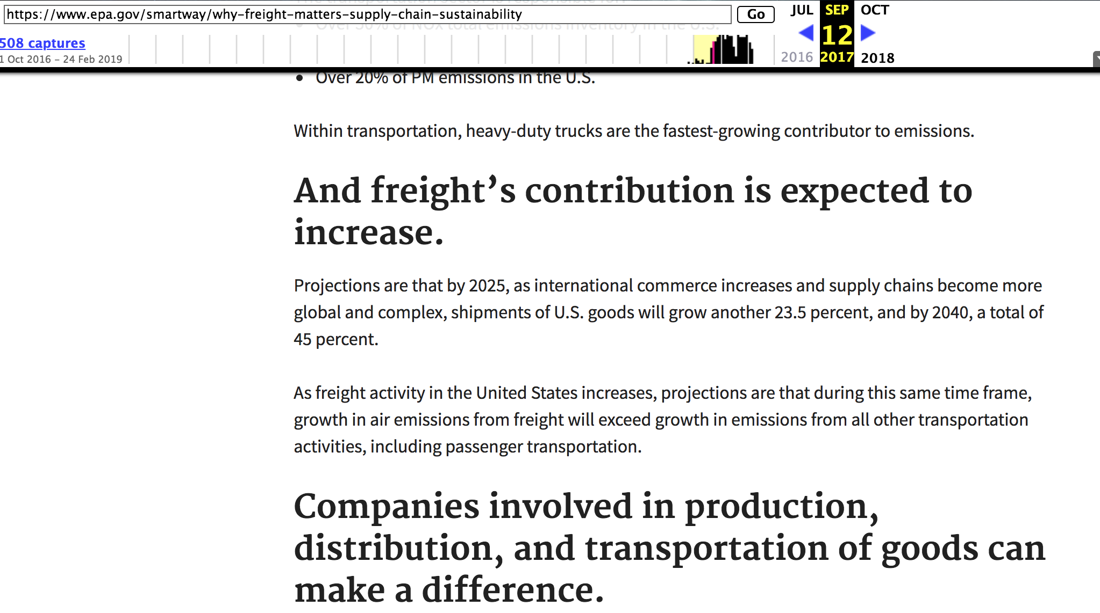
Changes to EPA’s SmartWay website
Removal of entire section titled “The science is clear - greenhouse gas emissions from all sources must decrease”
https://web.archive.org/web/20170208122205/https://www.epa.gov/smartway/why-freight-matters-supply-chain-sustainability
https://web.archive.org/web/20170912191105/https://www.epa.gov/smartway/why-freight-matters-supply-chain-sustainability

Slide 23
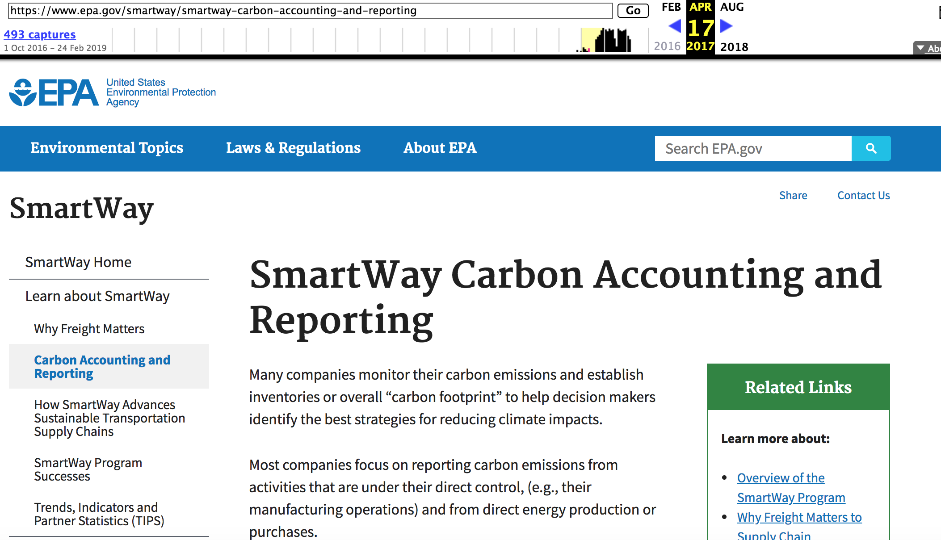
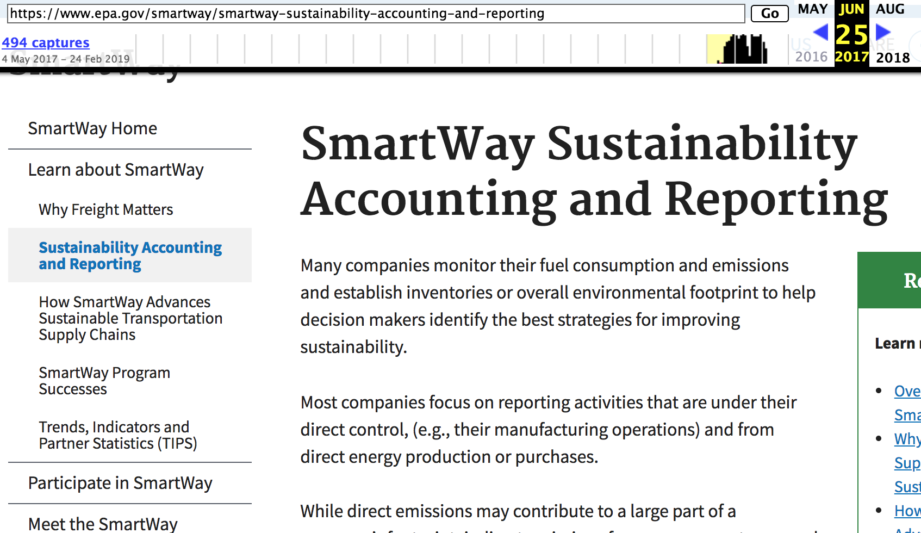
No mention of“carbon” and “greenhouse gasses” terms
Removed mentions of “carbon” and “greenhouse gasses” in favor of more general terms
https://web.archive.org/web/20170625081748/https://www.epa.gov/smartway/smartway-sustainability-accounting-and-reporting
https://web.archive.org/web/20170417083125/https://www.epa.gov/smartway/smartway-carbon-accounting-and-reporting

Slide 24
Others archives - National Institute of Environmental Health Sciences website
curl --silent http://memgator.cs.odu.edu/timemap/link/https://www.niehs.nih.gov/health/materials/index.cfm | grep datetime | awk '{print $1}' | awk -v FS=/ '{print $3}' | sort | uniq -c
2 arquivo.pt
58 wayback.archive-it.org
654 web.archive.org

Slide 25
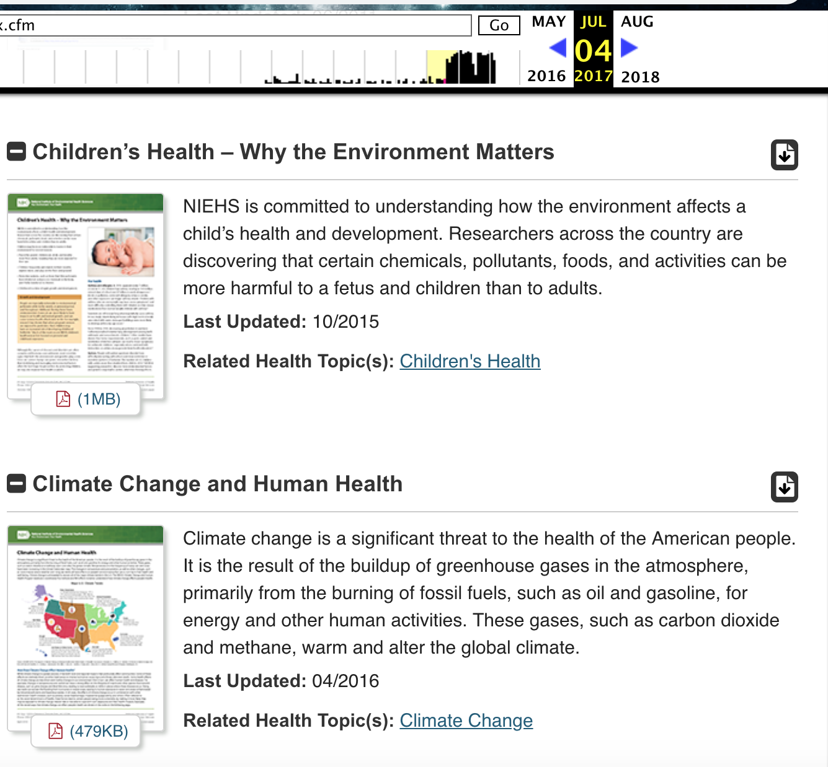
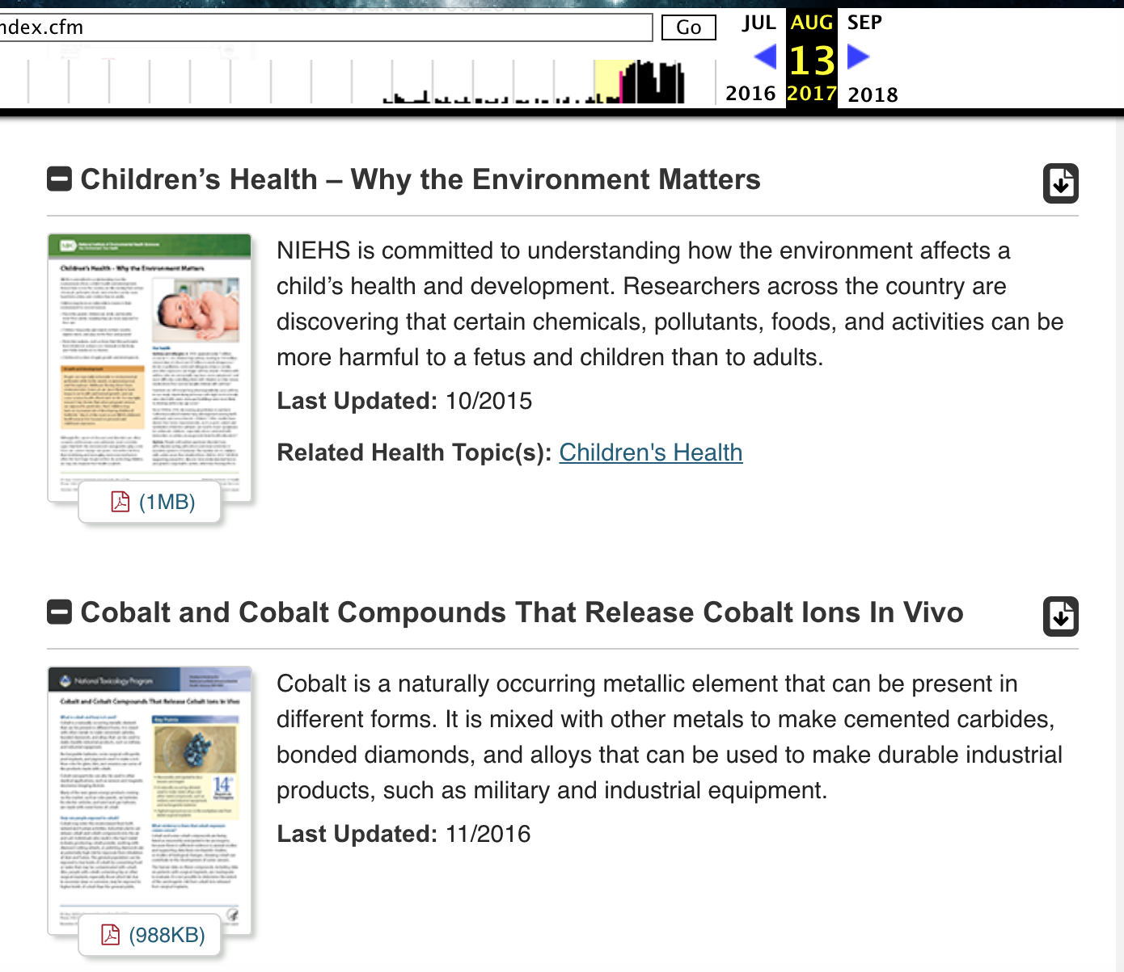
Section “Climate Change and Human Health” removed
https://web.archive.org/web/20170704175419/https://www.niehs.nih.gov/health/materials/index.cfm
https://web.archive.org/web/20170813232913/https://www.niehs.nih.gov/health/materials/index.cfm
https://envirodatagov.org/wp-content/uploads/2017/08/WM-CCR-17-NIH-Climate-Change-170820.pdf

Slide 26
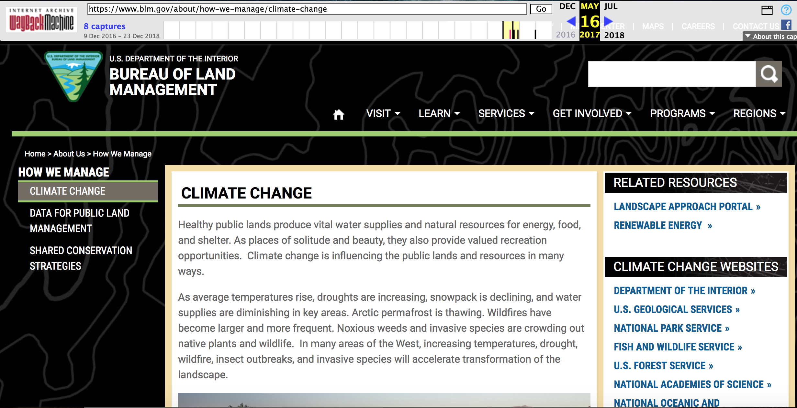
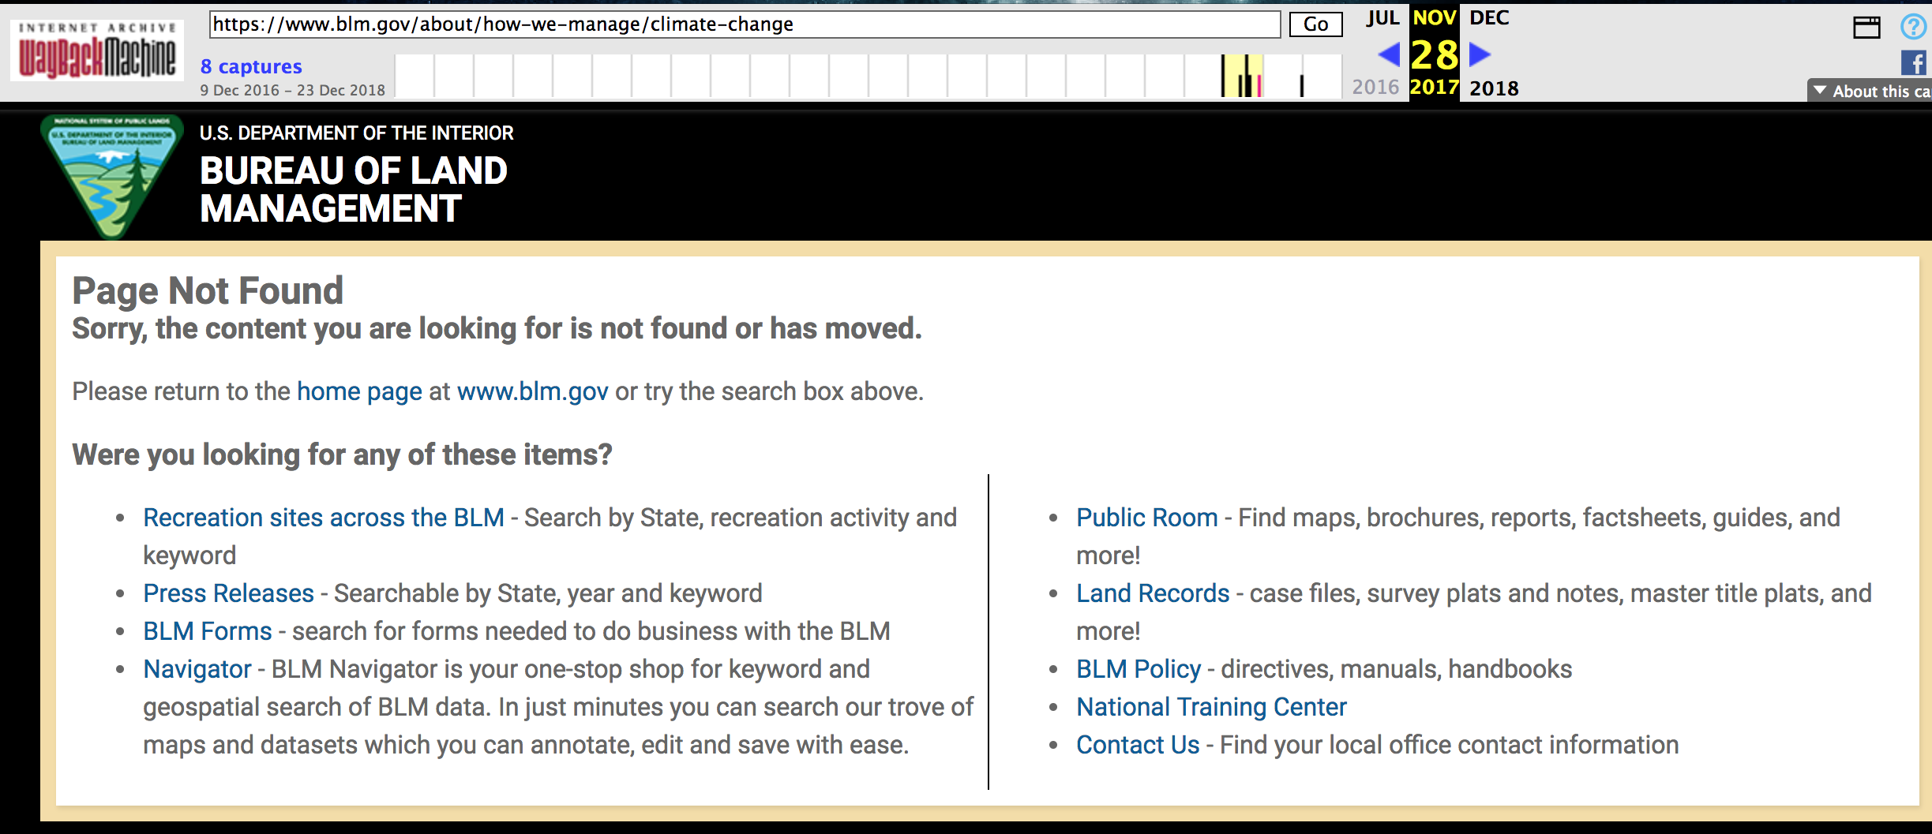
Department of the Interior’s Bureau of Land Management Climate website
Climate change page is Removed!
https://web.archive.org/web/20170516035341/https://www.blm.gov/about/how-we-manage/climate-change
https://web.archive.org/web/20171128175741/https://www.blm.gov/about/how-we-manage/climate-change

Slide 27
In other archives...
curl --silent http://memgator.cs.odu.edu/timemap/link/https://www.blm.gov/about | grep datetime | awk '{print $1}' | awk -v FS=/ '{print $3}' | sort | uniq -c
1 wayback.archive-it.org
18 web.archive.org

Slide 28
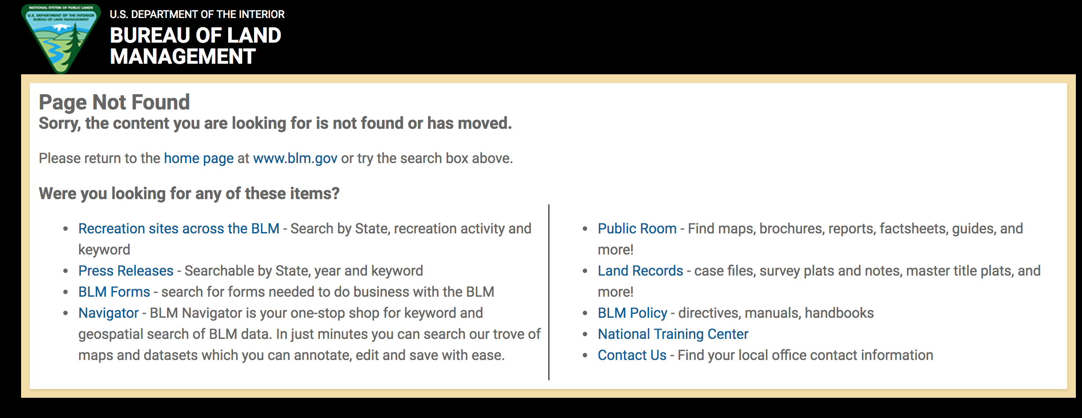
Now: Page Not Found!
curl -i https://www.blm.gov/about/how-we-manage/climate-change
HTTP/1.1 200 Not Found
Connection: Close
Content-Type: text/html
Strict-Transport-Security:max-age=31622400; includeSubDomains;

Slide 29
“epa.gov” on other archives
curl --silent http://memgator.cs.odu.edu/timemap/link/https://www.epa.gov/statelocalclimate | grep datetime | awk '{print $1}' | awk -v FS=/ '{print $3}' | sort | uniq -c
1 archive.md
5 arquivo.pt
1 perma-archives.org
15 swap.stanford.edu
94 wayback.archive-it.org
14351 web.archive.org

Slide 30
Redirecting “epa.gov” to a fresh site!
curl -i https://www.epa.gov/statelocalclimate
HTTP/1.1 301 Moved Permanently
Server: Apache
Location: https://www.epa.gov/statelocalenergy
Content-Length: 244
Content-Type: text/html; charset=iso-8859-1
Cache-Control: max-age=452254
Expires: Tue, 05 Mar 2019 00:31:40 GMT
Date: Wed, 27 Feb 2019 18:54:06 GMT
Connection: keep-alive
https://envirodatagov.org/wp-content/uploads/2018/01/Part-3-Changing-the-Digital-Climate.pdf#page=15&zoom=100,0,374

Slide 31
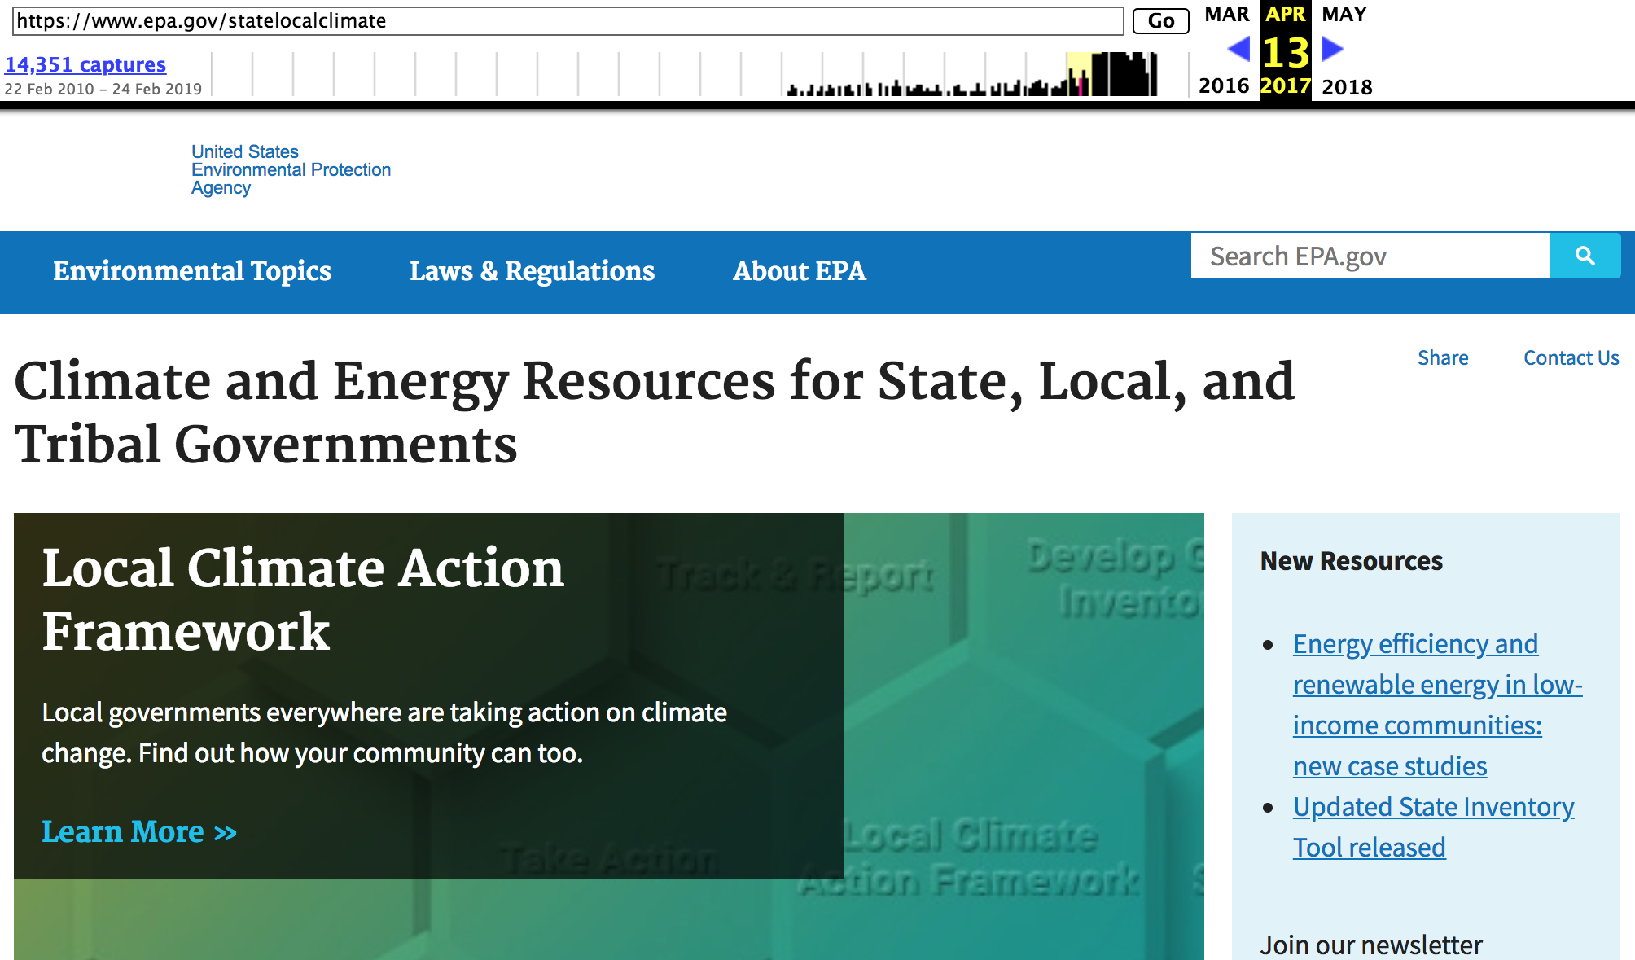
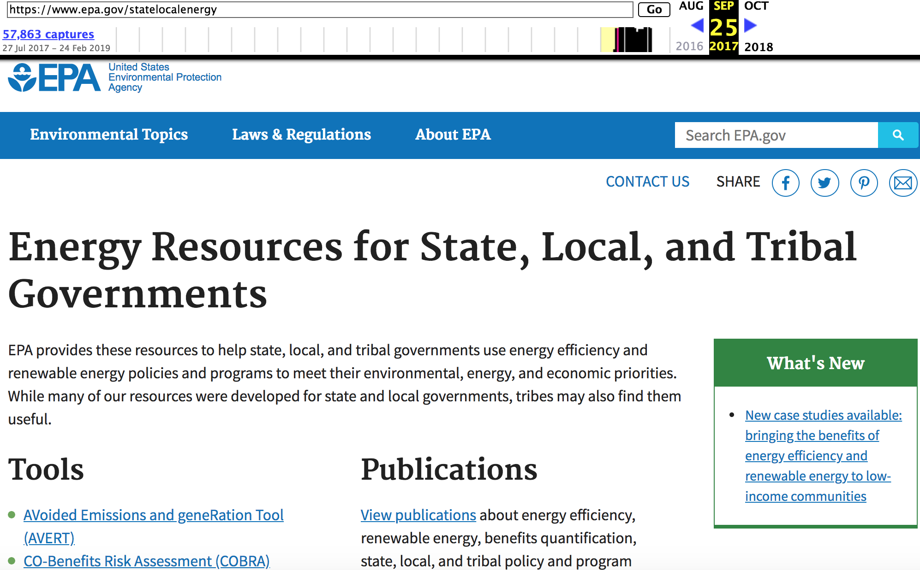
Alteration to EPA Climate Web Content
Replacement of the “Climate and Energy Resources for State, Local, and Tribal Governments” website with another that omits climate information.
https://web.archive.org/web/20170413052024/https://www.epa.gov/statelocalclimate
https://web.archive.org/web/20170925022922/https://www.epa.gov/statelocalenergy

Slide 32
Conclusion:
Combating climate change had less priorities in Trump administration compared with previous administrations.
Public Web content should be valued not only for its utility for education, as well as scientific and policy research, but also for historic worth.
Responsible Web archiving: Federal govt. must ensure that the content is preserved and made accessible through a public archive.
@WebSciDL @PuneethBikks

